Slide 1
KRISHNA ENGINEERING, Ghaziabad, UP
Department of Information Technology
Project Presentation-IV (VIII Sem), Session 2022-23
Sink mobility in WSN using multi-objective optimization algorithm
Project Domain: wireless sensor network
Project Group No: 12
Project Guide: Ms. Akshika Jain | TEAM MEMBERS: Tushar - 1901610130058 Chetan - 1901610130014 Pooja - 1901610130037

Slide 2
Contents
Introduction
Abstract
Problem Identification
Literature Review
Analysis of Problem
Proposed Methodology
Project Design
Timeline Graph
References

Slide 3
Introduction
Sink Mobility in a Wireless Sensor Network is a Energy Efficient Technique , the sink node moves on a trajectory in the network region and collects the data of the sensor nodes in the vicinity.
Monitors the environment or system by measuring physical parameters such as temperature, pressure, humidity.
Sensing + processing + communication

Slide 4
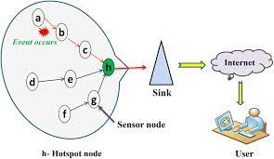
Introduction

Slide 5
Abstract
Wireless sensor network is a tremendously growing field wherein, users can design their sensor based application depending on the application requirements. Sink mobility to collect information in WSN is an interesting area. As a result a variety of mobility models were proposed by researchers over the years.

Slide 6
Abstract cont…
.
The goal of the work is to provide minimum battery consumption of nodes containing information from the environment by using some multi-objective optimization algorithms. We will apply the algorithm to a set of graphs, the result will demonstrate the benefit of involving sink mobility and they also suggests the desirable moving path of the sink.

Slide 7
Existing Approach
First Order Radio Model:
Currently, there is a great deal of research in the area of low-energy radios. Different assumptions about the radio characteristics, including energy dissipation in the transmit and receive modes, will change the advantages of different protocols.

Slide 8
In our work, we assume a simple model where the radio dissipates Eelec=50 nJ/bit to run the transmitter or receiver circuitry and €amp=100 pJ/bit/m² for the transmit amplifier to achieve an acceptable Eb /No .These parameters are slightly better than the current state-of-the-art in radio design. We also assume an r² energy loss due to channel transmission. Thus, to transmit a k-bit message a distance d using our radio model, the radio expands:

Slide 9
ETx(k,d)=ETx-elec(k)+ETX-amp(k,d) ETx(k,d)=Eelec*k+€amp*k*d² (1)
and to receive this message, the radio expands:
ERx(k)=ERx-elec(k)
ERx(k)=Eelec*k

Slide 10
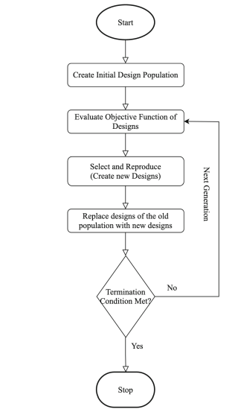
Genetic Algorithm
.

Slide 11
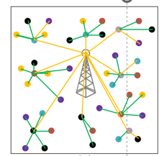
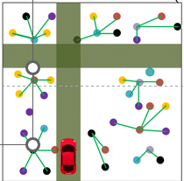
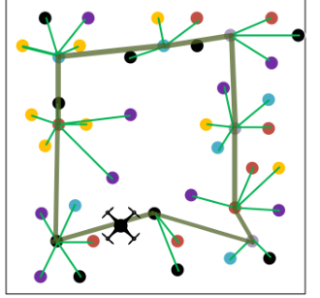
Sink Mobility
.
Ground Mobile Sink
Static Sink
Aerial Mobile Sink

Slide 12
Problem Identification
Maximum time WSN is alive so it can collect data .
The sensors in WSNs use batteries for power.
Most of the power is used for the communication of the sensors and the receiving or sending of the data. So if some nodes have much network traffic load their battery is depleted very fast and then the WSN is down .

Slide 13
Problem Identification Cont…
There must be smart data routing techniques an smart clustering of the nodes so the payload of the network traffic wont fall on the same nodes .
So to maximize the lifetime of one WSN we must look for smart routing ways and smart clustering ways like dynamic clustering .
A WSN must be like a living organism and rearrange the communication paths as needed.

Slide 14
Literature Review
Author | Article
FengS. et al. | Unknown hostile environment-oriented autonomous WSN deployment using a mobile Comput. Appl[1]
AgarwalV. et al. | A survey on path planning techniques for mobile sink in IoT-enabled wireless sensor networks Wirel. Pers. Commun [2]
NguyenL. et al. | Mobility based network lifetime in wireless sensor networks: A review Comput. Netw[3]
Z. Fei | A Survey of Multi-Objective Optimization in Wireless Sensor Networks: Metrics, Algorithms, and Open Problems[4]
V. L. Quintero | Improvements of Energy-Efficient Techniques in WSNs: A MAC-Protocol Approach[5]

Slide 15
Analysis of Problem
Battery consumption for a longer time may leads to dead nodes.
We may use sink mobility using multi objective optimization algorithm to minimize battery consumption.

Slide 16
Proposed Methodology
We will be using multi objective optimization algorithms such as GENETIC ALGORITHM (GA)
SHUFFLED SHEPHERD OPTIMIZATION
TREE PHYSIOLOGY OPTIMIZATION
AND many more.

Slide 17
Project Design
Step 1: Implementation of routing algorithm
Step 2: Creating sensor field with sink position
Step 3: Combining Multi objective Optimization Technique
Step 4: Sink Position will migrate

Slide 18
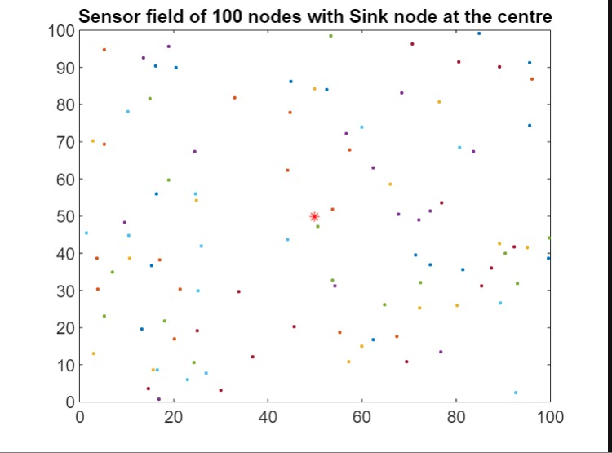
Implementation of simple sensor field having sink

Slide 19
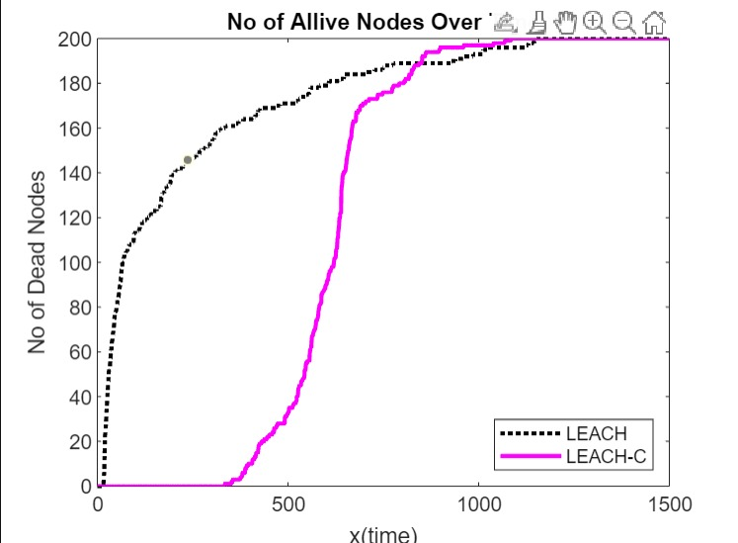
Leach vs Leach Centralized

Slide 20
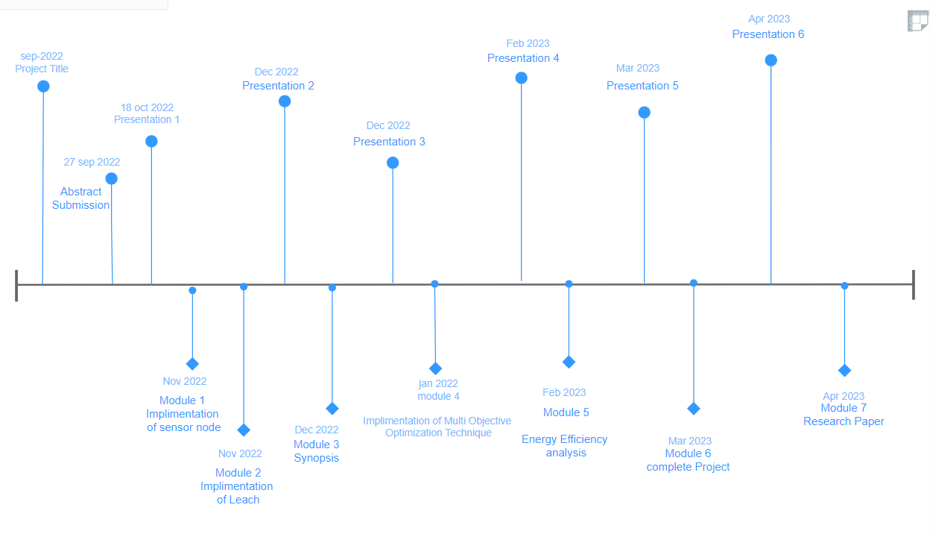
Timeline Graph

Slide 21
References
[1]FengS. et al.Unknown hostile environment-oriented autonomous WSN deployment using a mobile robotJ. Netw. Comput. Appl ,2021.
[2]AgarwalV. et al.A survey on path planning techniques for mobile sink in IoT-enabled wireless sensor networks Wirel. Pers. Commun ,2021
[3]NguyenL. et al.Mobility based network lifetime in wireless sensor networks: A review Comput. Netw ,2020.
[4] Z. Fei, B. Li, S. Yang, C. Xing, H. Chen and L. Hanzo, "A Survey of Multi-Objective Optimization in Wireless Sensor Networks: Metrics, Algorithms, and Open Problems," in IEEE Communications Surveys & Tutorials, vol. 19, no. 1, 2019
[5] V. L. Quintero, C. Estevez, M. E. Orchard and A. Pérez, "Improvements of Energy-Efficient Techniques in WSNs: A MAC-Protocol Approach," in IEEE Communications Surveys & Tutorials, vol. 21, no. 2, 2015

Slide 22
References
[6] W. B. Heinzelman, A. P. Chandrakasan, and H. Balakrishnan, “An application-
specific protocol architecture for wireless microsensor networks,” IEEE Transactions on wireless
communications, vol. 1, no. 4, pp. 660–670, 2012.
[7] W. B. Heinzelman, A. P. Chandrakasan, and H. Balakrishnan, “An application-specific protocol
architecture for wireless microsensor networks,” IEEE Transactions on wireless communications, vol. 1,
no. 4, pp. 660–670, 2012.
[8] O. Younis and S. Fahmy, “Heed: a hybrid, energy-efficient, distributed clustering approach for ad hoc
sensor networks,” IEEE Transactions on mobile computing, vol. 3, no. 4, pp. 366–379, 2010.
[9] V. Mhatre and C. Rosenberg, “Homogeneous vs heterogeneous clustered sensor networks: a
comparative study,” in Communications, 2004 IEEE International Conference on, vol. 6, pp. 3646–3651,
IEEE, 2010.

Slide 23
Status of Research Paper
Paper Title: Sink Mobility in WSN using multi-objective optimization algorithm
Paper Length:
Plagiarism status: 10%
Submission: Not Submitted
Date of submission: 5 may 2023
Status of submission:

Slide 24
Thank You !

